Slide 1



India Pandemic Tracker: COVID-19 Analytics
RA2211026010313 – Pratyush Rai
RA2211026010319- Aryan Singh
RA2211026010360- Neelansh bhargava

Slide 2
Introduction:
The COVID-19 pandemic has significantly impacted India, affecting millions of lives and the healthcare system.
With ever-evolving data, it's critical to analyze and visualize COVID-19 trends to inform decision-making, identify patterns, and understand the pandemic’s trajectory.
This dashboard provides an in-depth look at India’s COVID-19 statistics, including cases, vaccinations, recoveries, and testing rates across states and over time.

Slide 3

Objective:
Present key insights on the spread of COVID-19 in India.
Highlight vaccination progress, regional trends, and cases analysis.
Enable better understanding for policy-making, resource allocation, and public awareness.

Slide 4
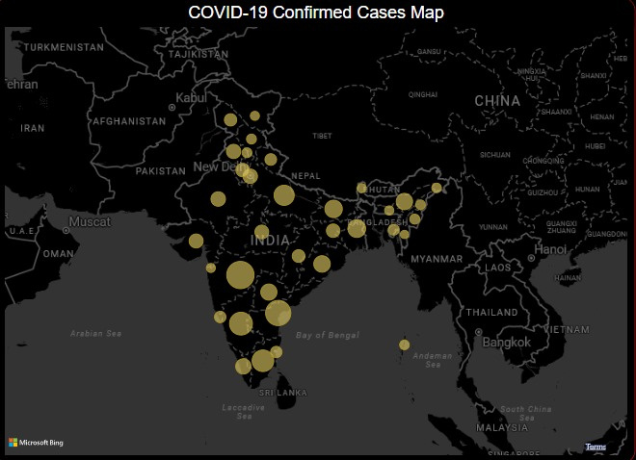
Geographical Distribution of COVID-19 Cases
This map shows the total number of cases caused by COVID-19 across Indian states.
States with higher case counts are highlighted in darker shades, indicating the severity of the pandemic's impact in those regions.
The distribution of cases can help us understand which states were most affected and may correlate with healthcare infrastructure, population density, and pandemic response measures.

Slide 5
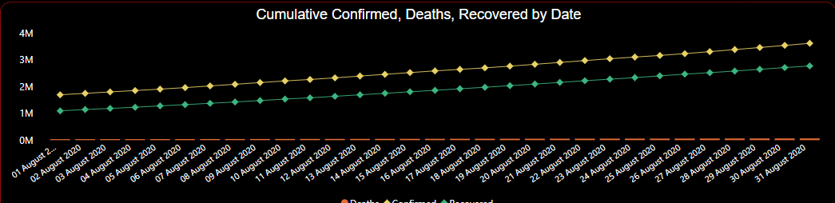
Cumulative Confirmed, Deaths, Recovered by Date
The yellow line shows the steady increase in confirmed cases throughout the month.
The green line reflects the number of recovered cases, which also rises but at a slightly slower pace than confirmed cases.
The orange line represents death cases, remaining relatively flat and close to the 0M mark, indicating a lower number of fatalities compared to confirmed and recovered cases.

Slide 6
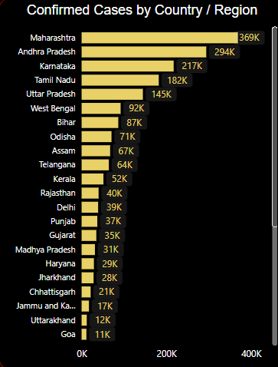
Confirmed Cases by Country / Region
Maharashtra tops the list with 369K confirmed cases, followed by Andhra Pradesh with 294K cases.
The data shows a significant concentration of cases in a few states, with Maharashtra, Andhra Pradesh, and Karnataka leading the numbers.
States like Goa, Uttarakhand, and Jammu and Kashmir report comparatively lower numbers, each with fewer than 20K cases.

Slide 7
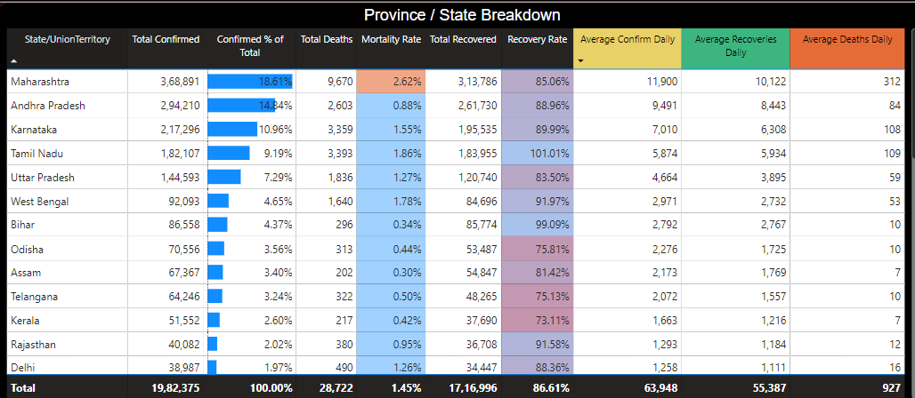
COVID-19 Statistics by State/Union Territory
Varied Impact: Different states experienced varying degrees of COVID-19 severity, showing that no single approach fits all.
Recovery Efforts: Effective recovery rates in many states demonstrate successful healthcare responses.
Mortality Rates: Lower mortality rates in several states indicate effective disease management and prevention strategies.

Slide 8
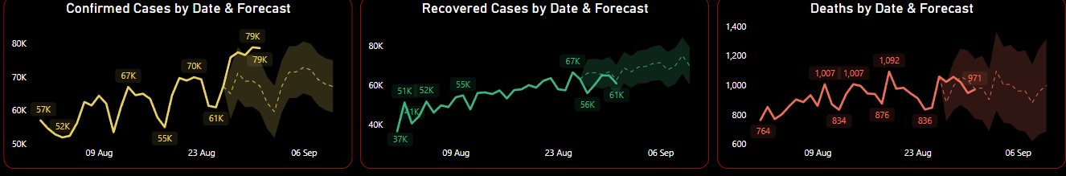
COVID-19 Cases, Recoveries, and Deaths Trends & Forecast
Confirmed Cases: The graph shows a consistent rise, with a significant increase forecasted.
Recovered Cases: The trend follows a similar upward pattern, suggesting effective recovery efforts.
Death Cases: The line remains relatively lower, indicating controlled fatality rates compared to other metrics.

Slide 9
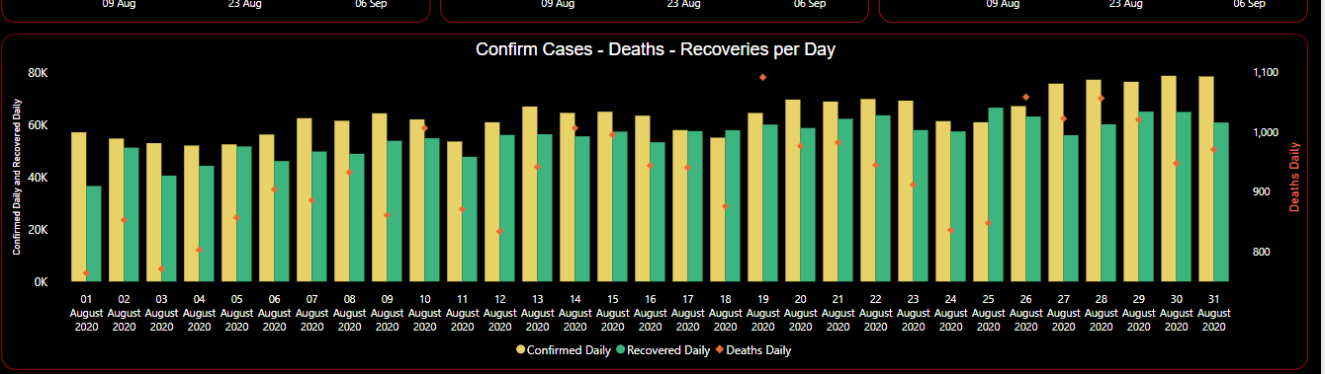
"Daily Confirmed Cases, Recovered, and Deaths -
Confirmed Cases (Yellow Bars): A consistent upward trend, highlighting the ongoing spread.
Recovered Cases (Green Bars): Steady increases, reflecting effective recovery efforts.
Deaths (Red Diamonds): A relatively stable number, showing controlled fatalities compared to confirmed and recovered cases.

Slide 10
Thank You

